Slide 1
Software Fault tolerance Part 2

Slide 2
Aperiodic Tasks: Adaptive Fault Tolerance
There are basically three fault tolerant approaches: TMR, PB, and Primary/Exception (PE).
One variation on PB is SCP-TMR, where the primary element consists of a duplex, forming a Self-Checking Pair (SCP). Self-checking is carried out by having each element of the duplex execute the task and comparing the results generated by them. If they agree, the self-check is passed; if they disagree, a third processor (the backup) is invoked and has the casting vote.

Slide 3
Periodic Tasks
There is a single processor and there is no requirement on the part of the algorithm to protect against hardware faults.
All tasks in the system are assumed to be periodic.
If the LCM of the periods is P, then the algorithm carries out preprocessing to fix the position of the alternatives in the schedule over the interval [0, P]. This same schedule then repeats endlessly. That is, if an alternative is scheduled to execute at some point in time t ∈ [0, P], it is also scheduled to execute at times t + P,t + 2P,....

Slide 4
Execution of Periodic Tasks
A is the union of intervals during which the alternatives are scheduled and α_{i} is the time when the alternative to task T_{i} is scheduled to start executing.
Before any primary starts executing, the system checks to see if enough time is available in the schedule to complete it. If not, execution of the primary is abandoned.
If the primary of task T_{i} finishes before α_{i}, its alternative is canceled and its assigned interval within the schedule is removed from A.
If the primary of task T_{i} does not finish before α_{i}, or it is known to have failed before then, all further execution of the primary is abandoned and the alternative starts executing.
Although α_{i} is the point at which a backup for task T_{i} is supposed to start executing, if the processor finds itself idle before then, it can start executing backups early. However, as mentioned previously, outside the set of intervals, A, the backup(s) have lower priority than primary tasks.

Slide 5
So we schedule a backup with execution time e_{b} and absolute deadline P to occupy the interval [P − e_{b}, P]. We then go backward from this point, scheduling backups in this way in descending order of their absolute deadlines, with ties being broken arbitrarily.

Slide 6
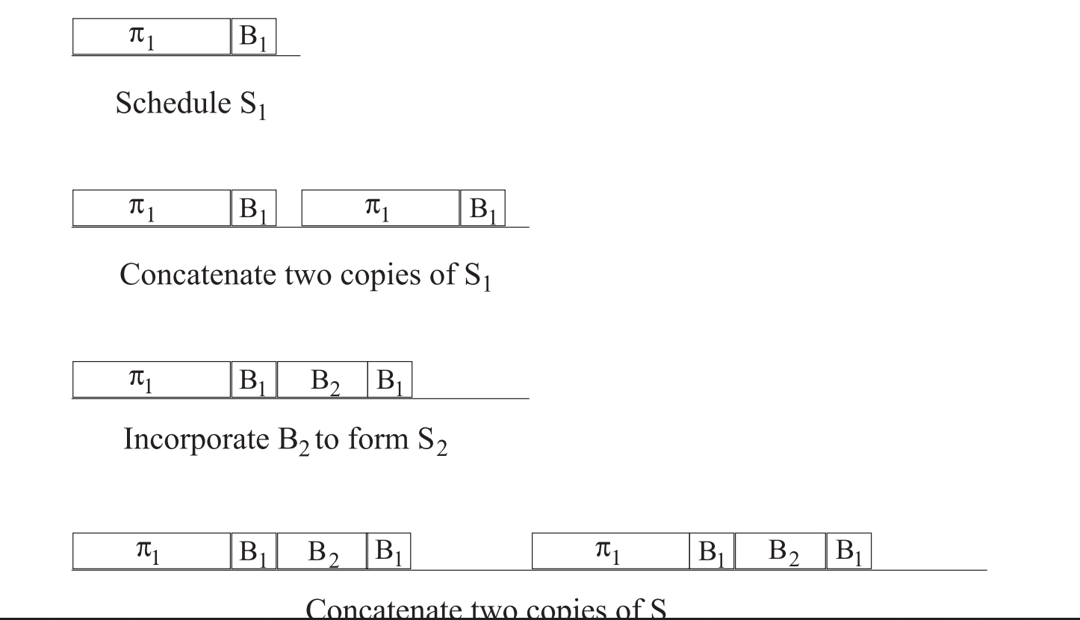
Fault-tolerant schedule example.

Slide 7
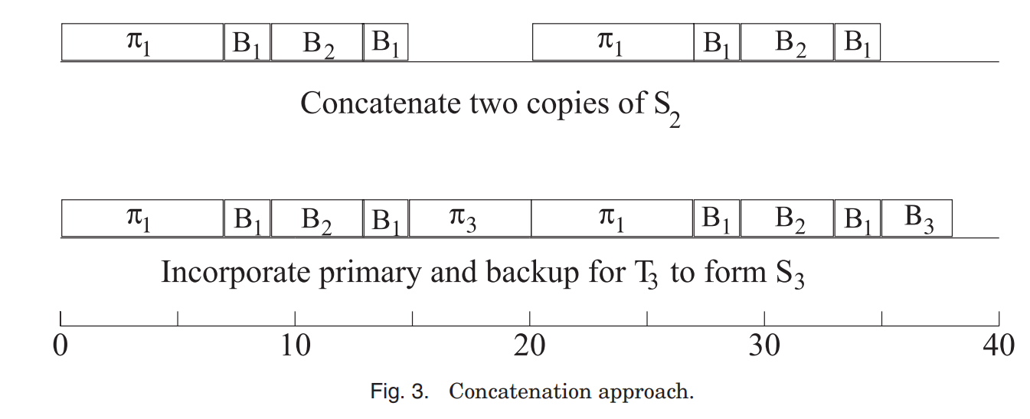
Example Continued…

Slide 8
A three-task system, with task periods P1 = 10, P2 = 20, P3 = 40; the primary execution times are e1 = 7, e2 = 4, e3 = 6, and the backup execution times are ξ1 = 2,ξ2 = 3,ξ3 = 3.
We construct S1, consisting of just the task T1. So it can easily schedule both the primary and backup copies. To construct S2, we concatenate two copies of S1 and use that as a framework within which to schedule T2(task 2). According to the time left with us we cannot schedule either the primary or backup of T2. So we drop one of the two iterations of π1: this releases enough time to schedule B2.
Finally, we construct S3. Concatenate two copies of S2: there is enough time to fit both a primary and a backup copy of T3 in this schedule.
So The scheduling algorithm must ensure that, at all times, the backup has enough time to execute successfully in the event that the primary does not.

Slide 9
Sporadic Tasks
For a sporadic task set , a dynamic scheduling approach can be taken. When tasks arrive, a server is responsible for deciding whether or not a task can be guaranteed execution within its deadline. If it cannot, the application is notified. If it can, primary and backup copies of the task are assigned to processors.
As tasks arrive, the scheduler checks the current loading of each of the processors. It then schedules the newly arriving tasks so that
(a) the primary and backup are not assigned to the same processor
(b) the backup is not scheduled to start before the scheduled completion time of the primary
(c) ensuring that failure of a single processor does not kill both copies of the same task
(d) that potentially wasteful overlapped execution of the primary and backup copies does not happen.

Slide 10
Permanent faults
The simplest way to deal with such faults is to have spare processors in the system. When a processor fails, its schedule is switched over to that of the replacement processor:-
We have processors with private rather than shared memory. Then one of two possibilities exist:
Copies of all tasks that this spare processor may have to execute are preloaded in its memory.
Once the system knows which tasks need to be run on the spare processor, those tasks can be loaded into its memory.
Having idle spares usually wastes energy. If all available processors are actively involved in executing the workload, the workload per processor is less.

Slide 11
Periodic Tasks
Task scheduling problem can be broken into two parts:-
task assignment and multiprocessor scheduling.
The first-fit algorithm can be used here. For each task, we identify the first processor on which it can be feasibly assigned. By this assignment, we mean that this task together with the tasks, if any, already assigned to that processor, can all meet their deadlines.They could follow any ordering—for example, we could choose to order the longer tasks (i.e., those with a longer WCET) first or simply pick them at random.

Slide 12
All Periods Equal
All of the tasks are periodic, have the same period, and are released at the same time. The idea is to assign one copy of each task to processors with the tasks being assigned in decreasing order of their execution times. Processors are grouped in pairs, and both processors in a pair are assigned exactly the same tasks. Once the tasks have been assigned, they can be scheduled. The tasks assigned to the same processor are scheduled in decreasing order of execution time.

Slide 13
General Task Periods
All task periods are equal and introduce the fault-tolerant assignment algorithm. All tasks have primary and backup copies associated with them.
Active or Primary Tasks: These are the tasks to be run in the absence of a failure.
Backup Tasks: These will be activated upon a processor failure that affects their corresponding active task.
Passive Backup Tasks: These tasks can be scheduled so that they start executing only after the scheduled completion time of their primary. As a result, they can remain dormant until that primary has failed.
Active Backup Tasks: If the schedule is so tight that we cannot find time to schedule the tasks as passive backups, they must be scheduled as active backups. That is, they must start running even before we know that their primary has failed since there will be no time to execute them to completion if we wait until we know that the primary task has failed.

Slide 14
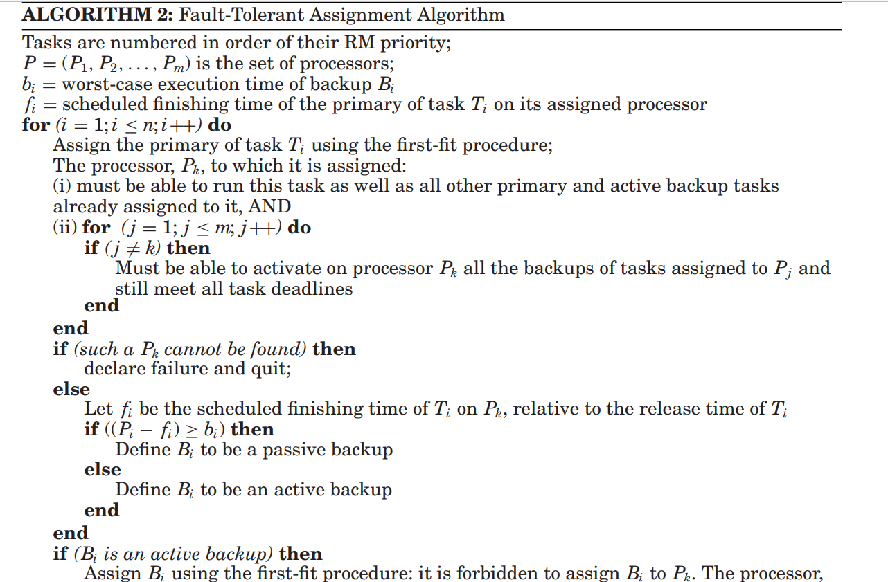
Algorithm

Slide 15
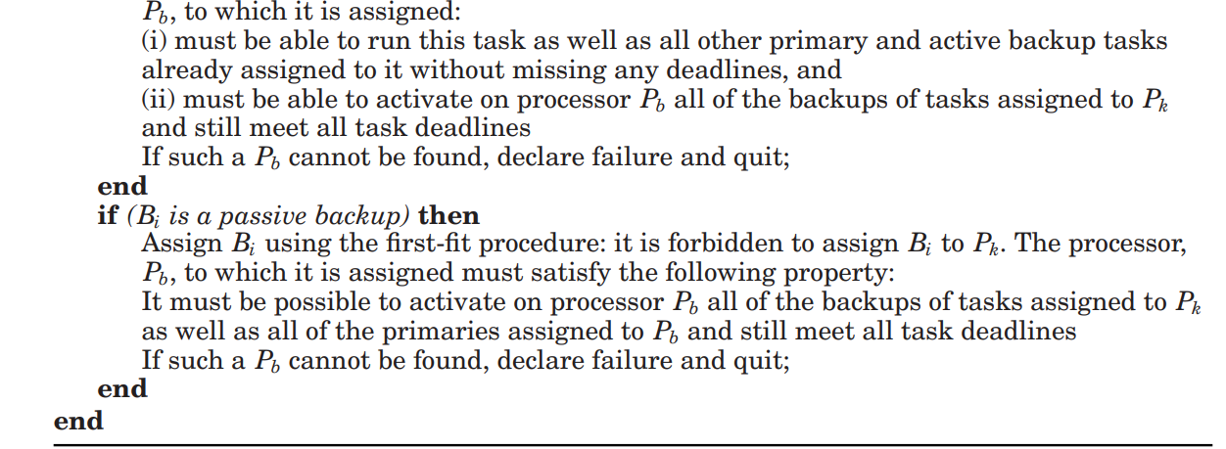

Slide 16
Sporadic and Nonpreemptive Tasks
tasks arrive dynamically
when a task arrives the system determines if it has enough time to guarantee its execution. If so, the task is accepted; if not, the task is rejected and is no longer its responsibility
This starts by scheduling the primary copy of the incoming task by using use a first-fit approach to choose the processor that will be allocated as the primary.
Also we can find a processor that can feasibly schedule this primary, we try to identify a processor that can feasibly schedule its backup.

Slide 17
Dynamic Programming Approach
It is an offline technique, in which multiple schedules are constructed for each processor. The first is the backup schedule, the second a primary schedule, and the rest are the contingency schedules to be invoked upon backup activation.
In the absence of faults, the primary schedule is executed. When a backup needs to be activated, this is done according to the backup schedule, with primary tasks having to give way to the backup’s. Hence they are passive backups.
the dynamic programming approach can use any scheduling algorithm that consists of a task assignment part and a uniprocessor scheduling part.

Slide 18
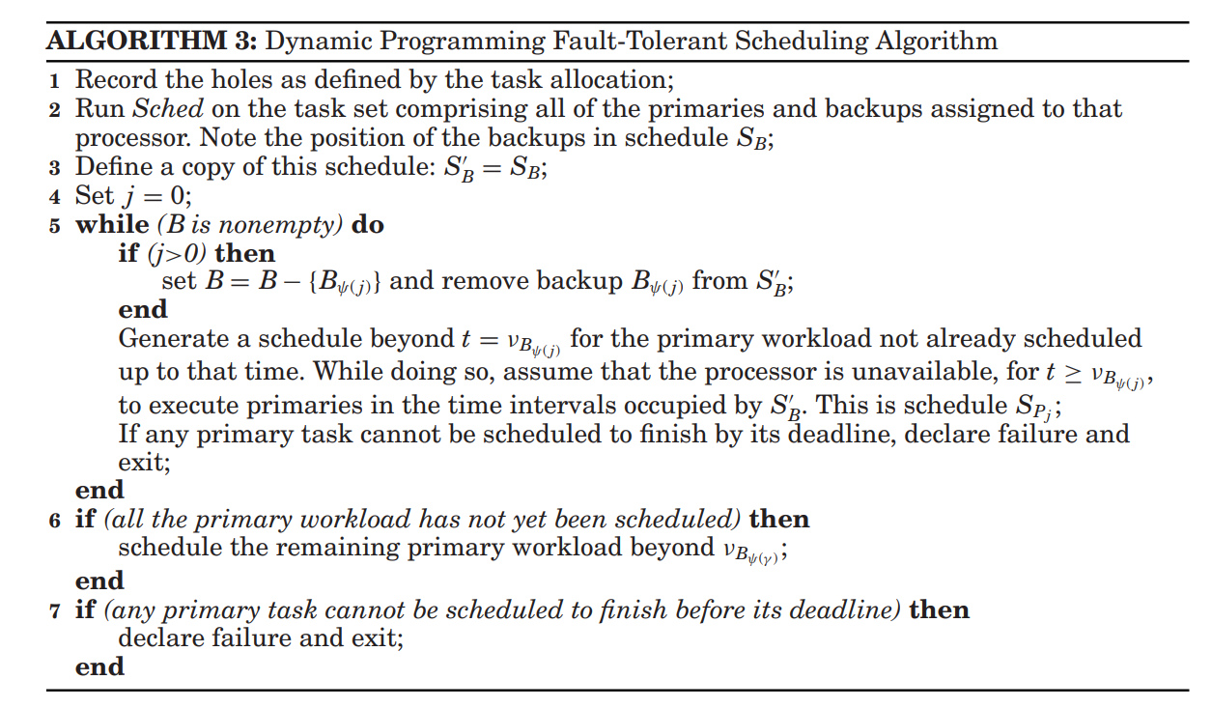
Algorithm

Slide 19
.A hole is a interval of time in which it is impossible to schedule any of the primaries allocated to that processor due to their release times and deadlines. For example, if we have a processor assigned a single sporadic task whose release time is r and absolute deadline is d, then the following intervals are holes created by that task: [0, r) and (d,∞).
Let ν_{Bψ(1)} ,ν_{Bψ(2)} ,...,ν_{Bψ(γ )} be the notification times of backups respectively assigned to that processor. For convenience, set ν_{Bψ (0)} = 0 and ν_{Bψ(γ +1)} = ∞. The algorithm generates a sequence of γ +1 primary schedules, S_{p0}, S_{p1},..., S_{pγ} , and then pieces them together.
The position of the backups in this schedule is recorded in a backup schedule, S_{B}. The position of the primaries in the schedule is recorded in schedule S_{p0}.

Slide 20
Conclusion
Real-time systems are becoming ever more widely used in life-critical applications, and the need for fault-tolerant scheduling can only grow in the years ahead. In this article, some techniques for fault-tolerant scheduling in homogeneous systems have been outlined. All of these algorithms have one objective: to guarantee that, despite a certain maximum number of faults, the tasks will have enough hardware and time redundancy to meet their deadlines. In a heterogeneous system, tasks can have different execution times on different processors. If nodes are heterogeneous, they are also likely to differ in their failure characteristics, both in the rate with which they fail and also the temporal characteristics of their transient failure.

